Slide 1


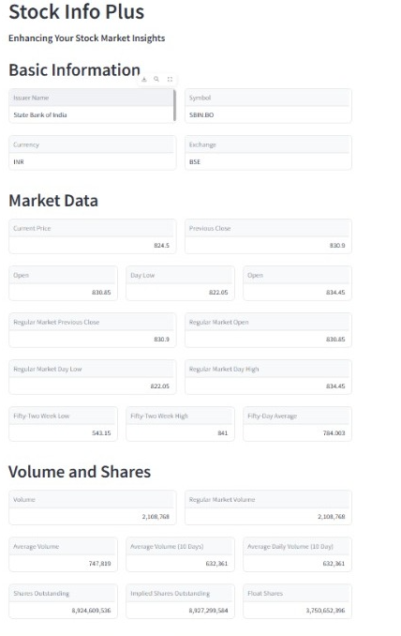
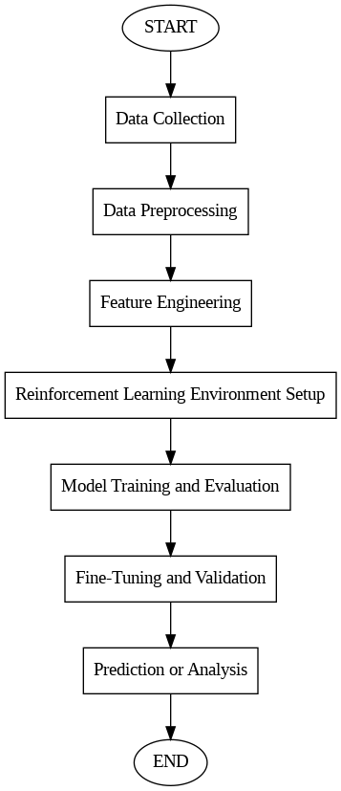
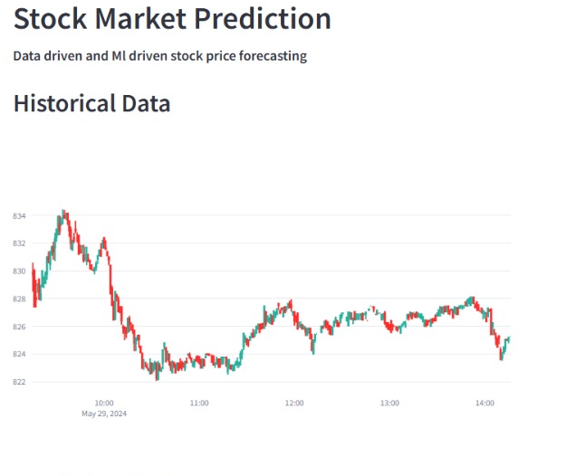
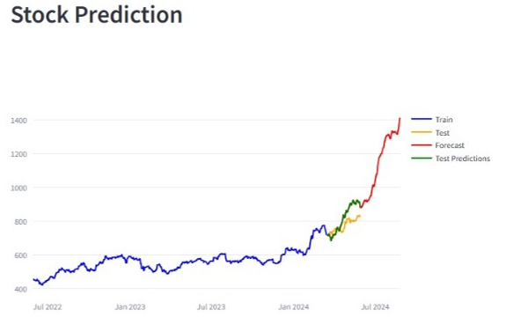

STOCK MARKET PREDICTION USING ML
Department : MCA
Name: Diviya Pandit(2022D1R005)|Riya Sharma(2022D1R006)
Abstract
Stock info fetched at runtime
Stock market prediction has garnered significant attention due to its potential impact on investment decision-making and financial outcomes. Financial markets pose significant challenges for investors due to their inherent complexity and volatility.
In recent years, machine learning techniques, particularly reinforcement learning (RL), have emerged as promising tools for improving predictive accuracy in this domain. Leveraging historical stock price data from the National Stock Exchange (NSE), this project seeks to investigate the potential of RL in predicting stock price movements.
The NSE provides a rich dataset encompassing a wide range of stocks, making it an ideal platform for exploring the applicability of RL techniques. By adapting to changing market conditions and learning from past experiences, RL models offer the prospect of identifying profitable trading opportunities in the NSE.
In summary, this project aims to leverage RL to navigate the complexities of financial markets, with the ultimate goal of enhancing predictive capabilities and providing valuable insights for investors operating on the NSE.
Innovation & Impact
INNOVATION:
Time series forecasting.
Analysis of all companies listed on Indian stock market.
IMPACT:
Knowledge based and decision making for stock market trading
Functional Workflow
Historical Data fetched
.
Stock market forecasting
Language(s) | Technology Stack
LANGUAGES:
PYTHON
TECHNOLOGY STACK:
MACHINE LEARNING
REINFORCEMENT ML
AUTO REGRESSION MODELS
API(S):
Y FINANCE

